Slide 1
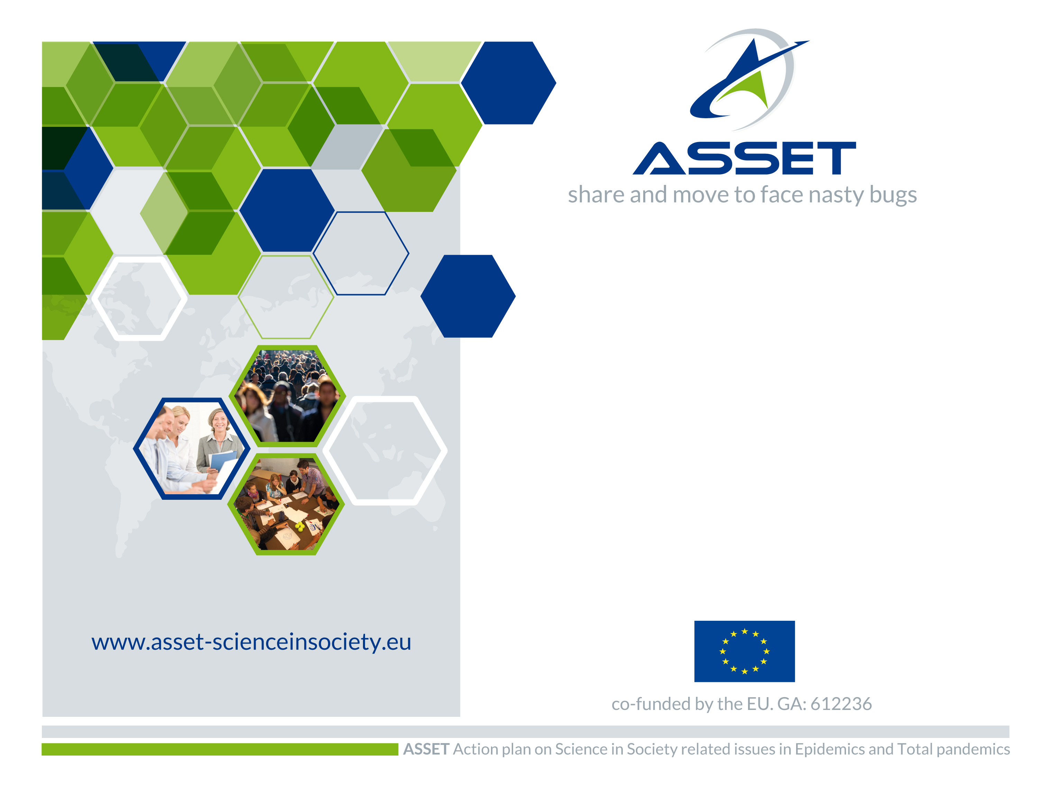
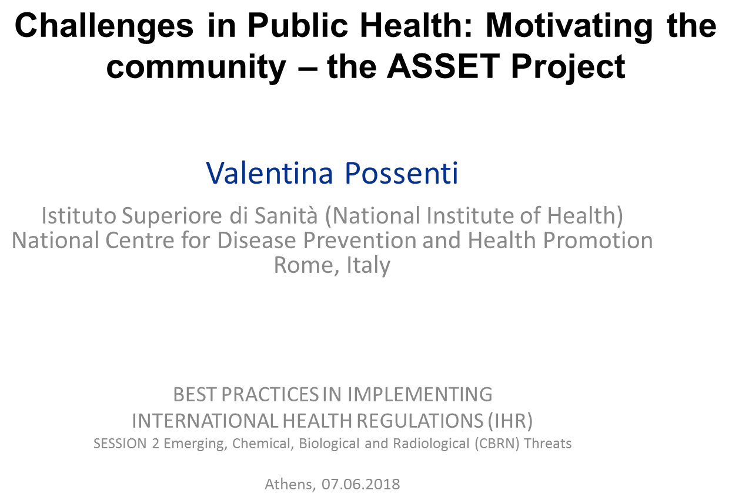
Notes:
Abstract. Epidemics and pandemics are natural events recurring over the time: their impact can be appropriately minimised but countries mostly rely on emergency response rather than preparedness strategies. As per the European Decision 1082/2013 on serious cross-border threats to health, risk communication represents an essential tool in coping with public health emergencies of international concern (PHEIC). The Decision has served as proper context for the EU-funded ASSET (Action plan in Science in Society in Epidemics and Total pandemics; 2014-2017) research project that outlined strategies for a better response to PHEIC concerning Science-in-Society issues (governance, engagement, ethics, gender, science education, open access) within the framework for responsible research and innovation (RRI). A Mobilization and Mutual Learning (MML) approach was developed through the ASSET Strategic and Action Plans toward different targets and relevant stakeholders in the field. An integrated participatory approach needs to be recognized into the national plans for preparedness and response.
Keywords: public health emergencies of international concern (PHEIC) - Science-in-Society (SiS) - Mobilization and Mutual Learning (MML) - preparedness and response - community participation - communication

Slide 2
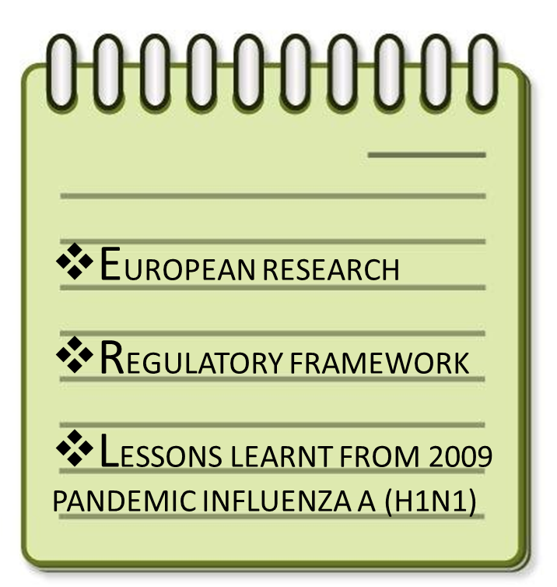
BACKGROUND

Slide 3



RESEARCH FRAMEWORK
EU Commission’s Science and Society Action Plan
In 7th Framework Programme for Research and Technological Development (FP7) Science-in-Society (SiS) to foster public engagement and a sustained two-way dialogue between science and civil society
Responsible Research and Innovation (RRI) to setup and develop policies via participatory approaches, driven by needs of all societal players and responding to the aspirations and ambitions of EU citizens
Currently Science with and for Society (SwafS) in H2020
Notes:
FP7 was the European Union's Research and Innovation funding programme for 2007-2013.
The current programme is Horizon 2020 but there are many projects funded under FP7 which are still running.
'Science in Society' aims to bridge the gap between science professionals and those without a formal science education and to promote a taste for scientific culture in the public at large. Associated paradigm makes community give researchers inputs and sparks which are useful to develop further research on one hand and researchers who are available to communicate health messages on the other hand

Slide 4

SCIENCE-IN-SOCIETY PARADIGM
“The dialogue between science and the rest of society has never been more important. As the Europe 2020 Strategy makes clear, to overcome the current economic crisis we need to create a smarter, greener economy, where our prosperity will come from research and innovation. Science is the basis for a better future and the bedrock of a knowledge- based society and a healthy economy. After ten years of action at EU level to develop and promote the role of science in society, at least one thing is very clear: we can only find the right answers to the challenges we face by involving as many stakeholders as possible in the research and innovation process. Research and innovation must respond to the needs and ambitions of society, reflect its values, and be responsible. To my mind, there are a number of keys to doing this”.
M. GEOGHEGAN-QUINN, European Commissioner for Research, Innovation and Science
Message delivered at the conference «Science in Dialogue - Towards a European Model
for Responsible Research and Innovation» Odense, Denmark, 23-25 April 2012
Notes:
EU FRAMEWORK: INCLUSION

Slide 5
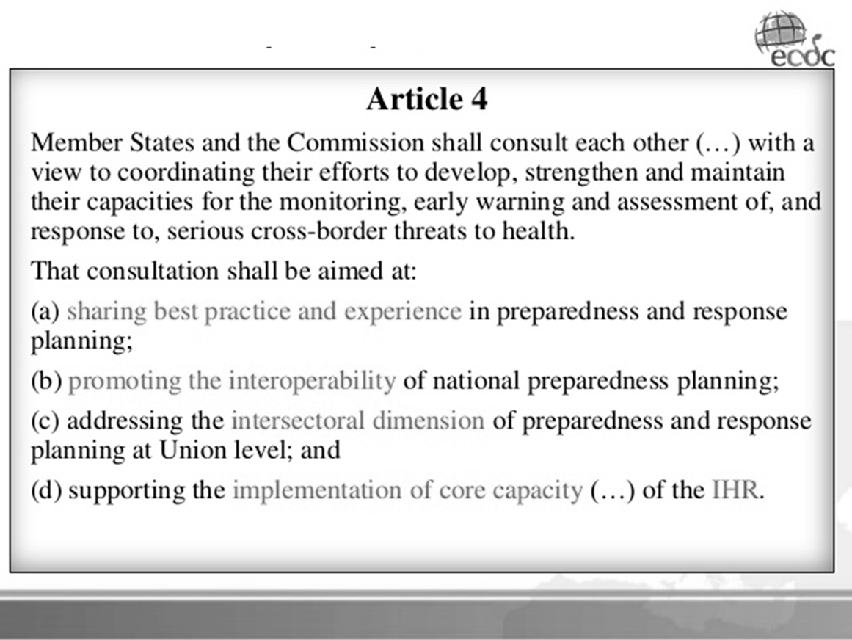
EU DECISION 1082/2013
Notes:
1082/2013/EU decision on serious cross border threats to health

Slide 6
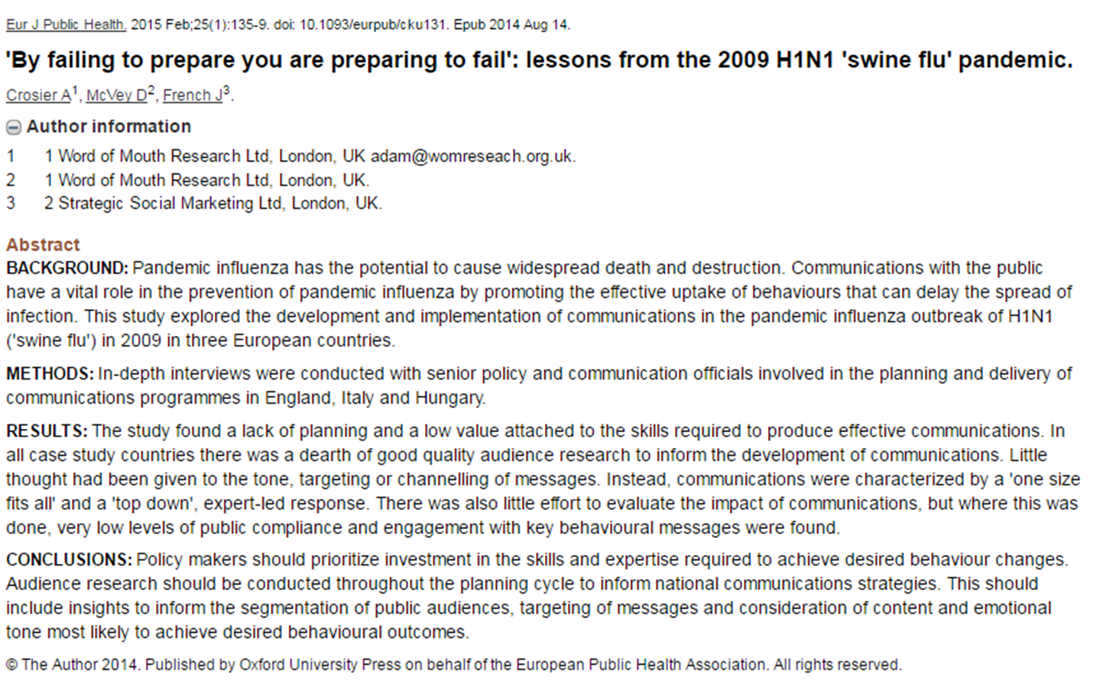
PANDEMIC COMMUNICATION

Slide 7
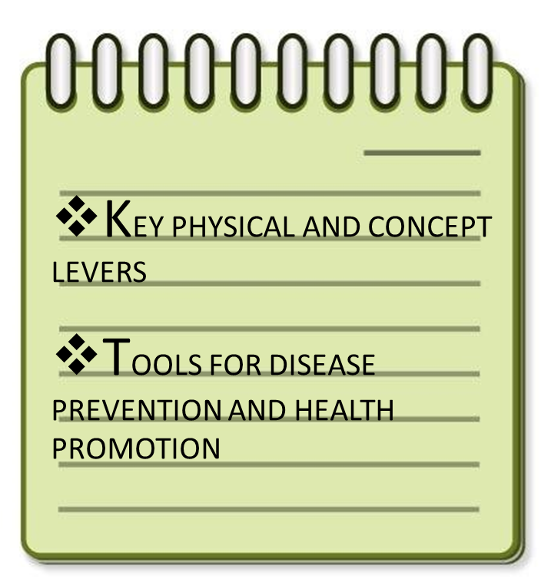
METHODS
Notes:
In the broader context of:
• prevention and control of communicable diseases and health security; • strengthening of health and public health systems; • support to health services in countries affected by emergencies and public health crises;
ASSET posed:
strategies for action to tackle and to deal with present and emerging health challenges; • partnerships for participation and policy implementation; • innovative tools and approaches; • information for monitoring and evaluation.

Slide 8
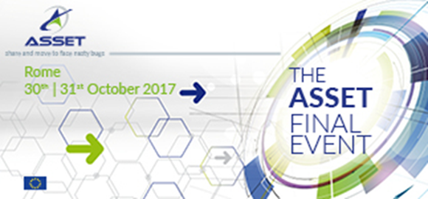
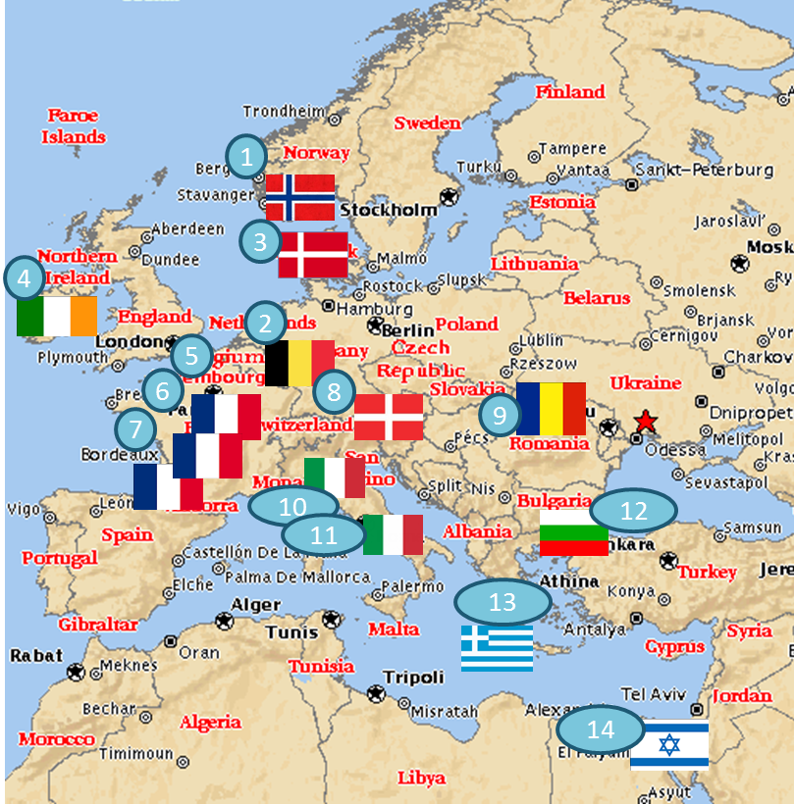
ASSET FEATURES
Forskninginstitutt, FFI
The International Emergency Management Society, TIEMS
Forsvarets Fonden Teknologiradet, DBT
European Institute of Women’s Health, EIWH
ABSISKEY
LYONBIOPOLE
International Prevention Research Institut, IPRI
Datamining International, DMI
Universitatea de Medicina si Farmacie Carol Davila din Bucuresti, UMFDB
ZADIG SRL
Istituto Superiore di Sanità, ISS (Scientific Coordinator)
National Center of Infectious and Parasitic Diseases, NCIPD
Institute of Preventive Medicine Environmental and Occupational Health, PROLEPSIS
University of Haifa, HU
Notes:
4 years old (2014-2017)
14 Partners involved
11 Countries covered in the Consortium

Slide 9
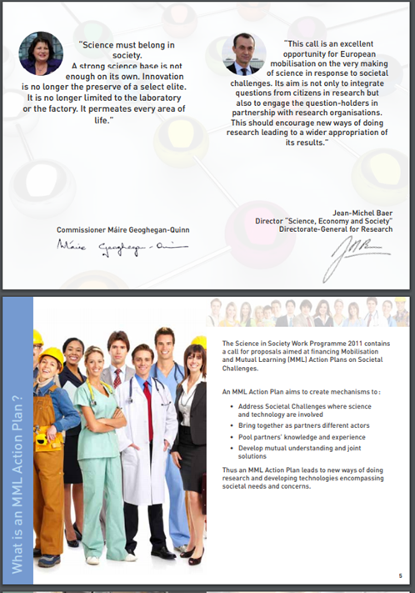
ASSET OBJECTIVES
common approach and LANGUAGE
Cooperative multidisciplinary ACTION
PHEIC scientific and societal challenges
PUBLIC engagement
MOBILISING relevant stakeholders and promoting MUTUAL LEARNING processes
To a broader purpose of TRUST restoring among scientists, researchers, policy makers and lay public
Notes:
ASSET aims to
forge a partnership with complementary perspectives, knowledge and experiences to address effectively scientific and societal challenges raised by pandemics and associated crisis management;
explore and map SiS-related issues in pandemics and/or epidemics;
define and test a participatory and inclusive strategy to succeed;
identify necessary resources to make sustainable the action after the project completion.

Slide 10
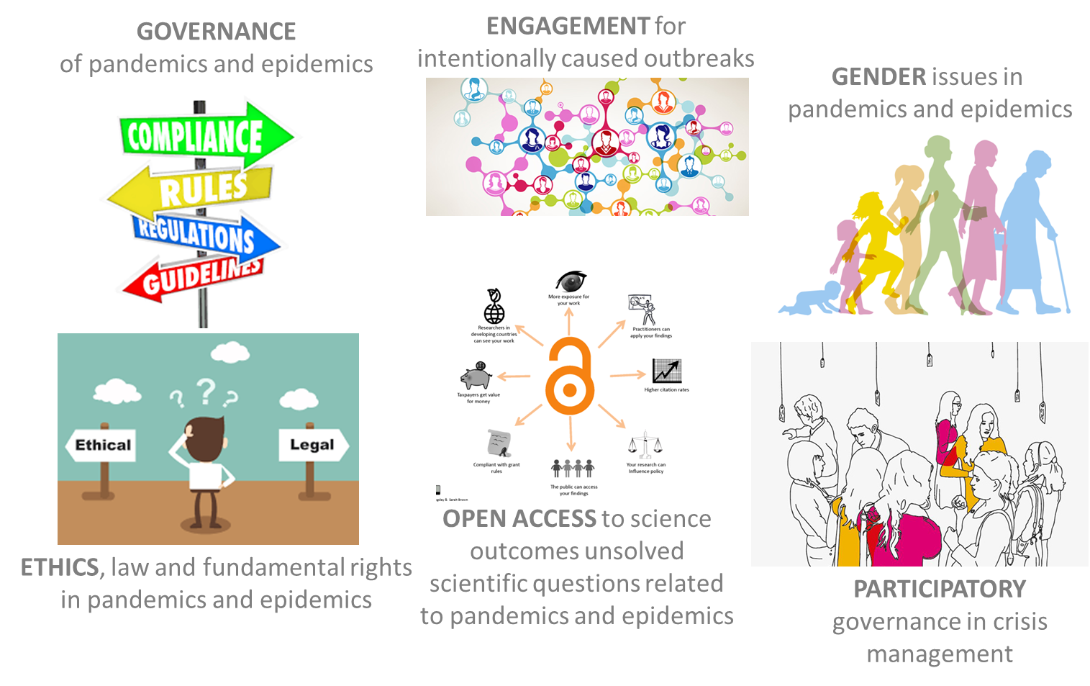
ASSET SIS-RRI KEYWORDS
Notes:
2001: SaS, 2007: SiS, 2011: SwafS
Science in Society – SiS
Responsible Research and Innovation– RRI
Mobilisation and Mutual Learning Action Plan – MMLAP
RRI ASSET
Engagement ICOs
Gender equity GENDER
Science education PART. GOVERNANCE
Open access TO SCIENCE OUTCOMES UNSOLVED QES
Ethics ETHICS
Governance GOVERNANCE

Slide 11

PARTICIPATORY ACTION RESEARCH IN ASSET
RESEARCH
Mind, inquiry
Knowledge
ACTION
Experience,
Transformative
PARTICIPATORY
Life in society
Democracy

Slide 12
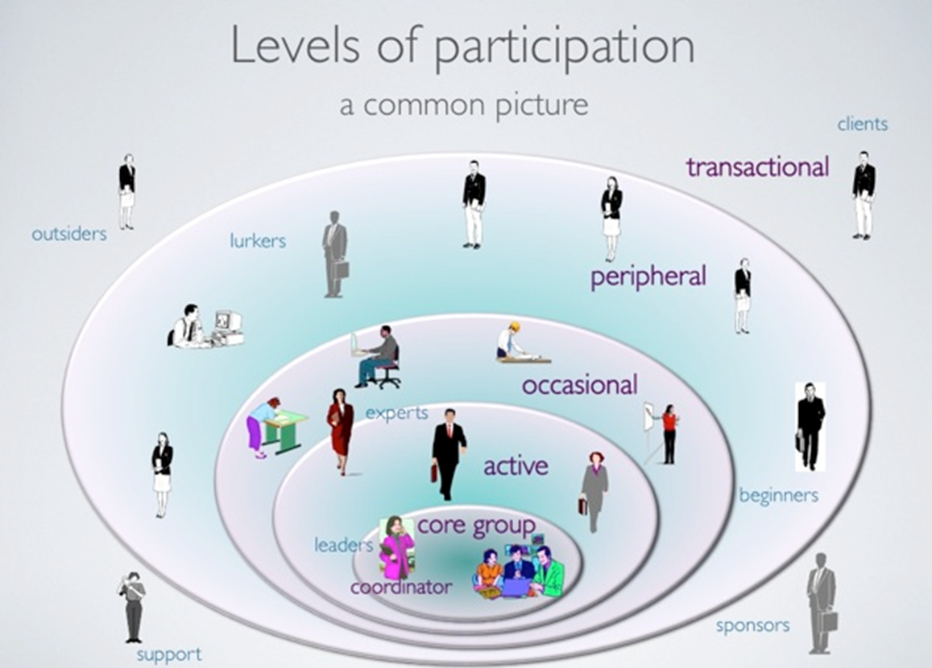
ASSET AS COMMUNITY OF PRACTICE
Wenger E. Communities of practice: learning, meaning and identity, Cambridge University Press, New York 1998
Notes:
INTERNAL Communication: to make Mutual Learning operational within the Consortium…
the rationale of Community of Practice (CoP) has been theorized by E. Wenger.
Starting from the three interrelated dimension of CoPs (domain, community, practice), their key-function was outlined that is generating new knowledge, expertise and practice.
In a CoP different levels of participation and possible applications occur.
strengths and limits of this collaborative way of mutual learning; in practice, using Moodle (an Open Source Learning Management System) as Web environment for CoP’s development.

Slide 13
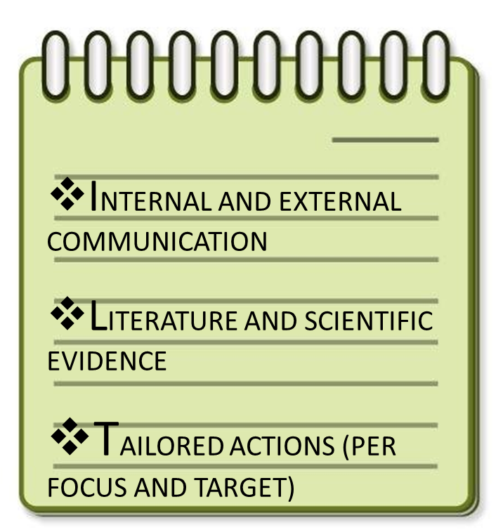
RESULTS
Notes:
strategies for action to tackle and to deal with present and emerging health challenges; • partnerships for participation and policy implementation; • innovative tools and approaches; • information for monitoring and evaluation.

Slide 14
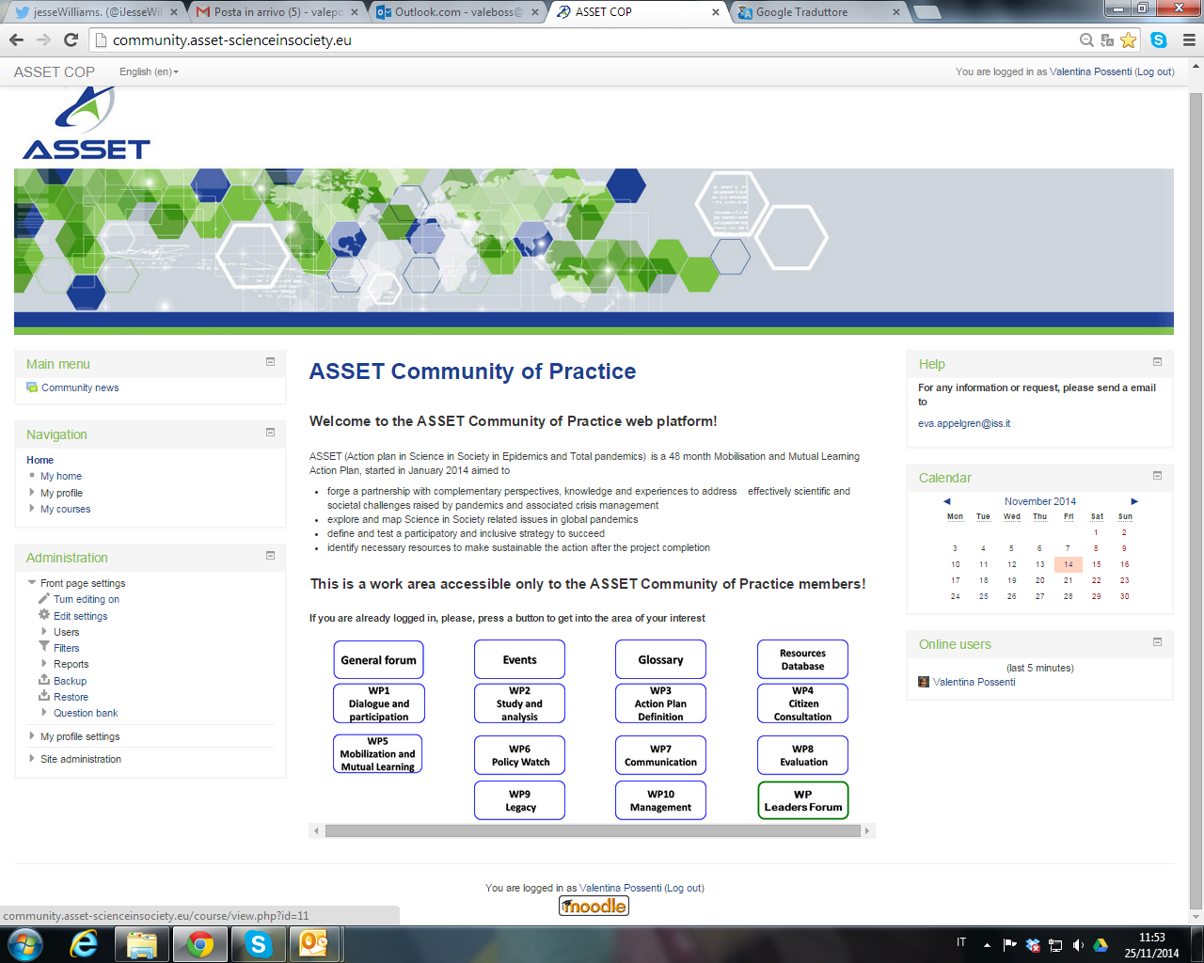
ASSET COMMUNITY OF PRACTICE
Notes:
That’s our engine! Based on an open source platform (Moodle)

Slide 15
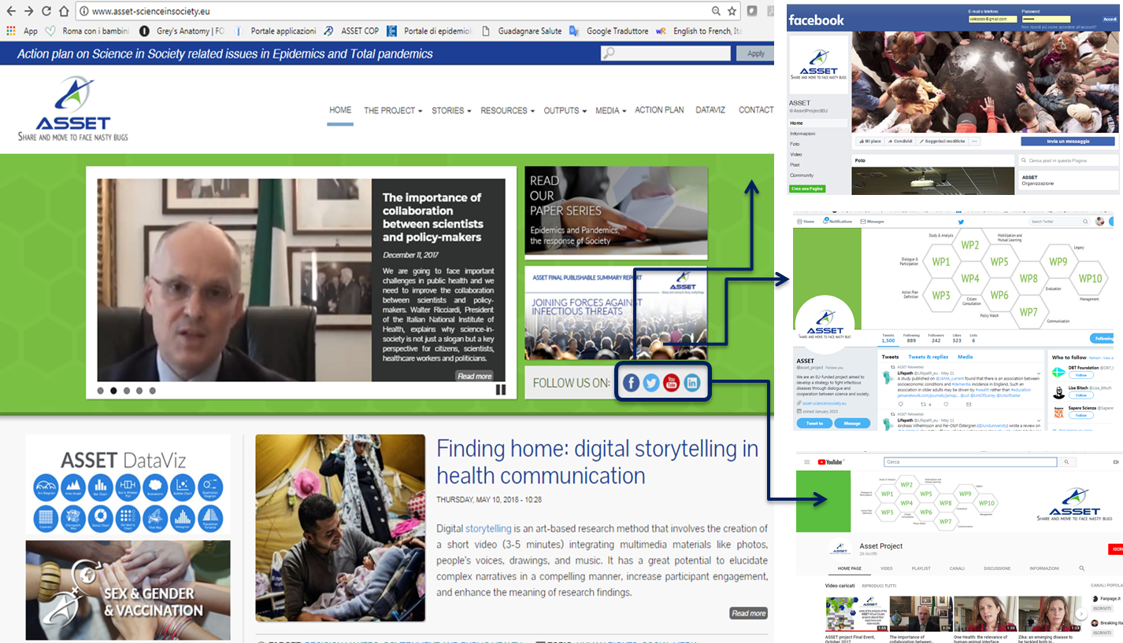
ASSET HTTP://WWW.WINDOWS
Notes:
On line ASSET : a coordinated web-package made of its own site as well as main social media profiles and pages (Twitter, Facebook, Youtube; also LinkedIn)

Slide 16
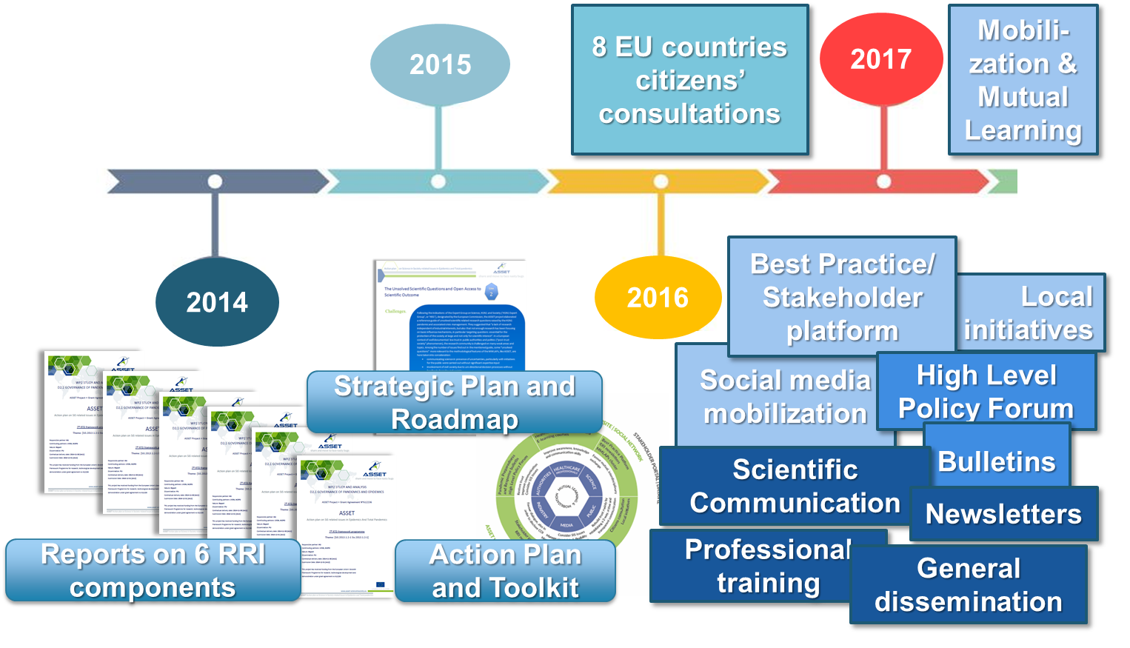
ASSET CAPITALS
Notes:
IN TERMS OF OUTPUTS AND HOPEFULLY OUTCOMES
That’s the time bar for the four years: the idea was to put inputs below the line and outputs and outcomes above the line.
Indeed, since the first project year what was released represented a project output sure, but served also as input to inform other actions that followed. Instead of a lienar progression, the circle standing for project life-cycle was achieved.

Slide 17
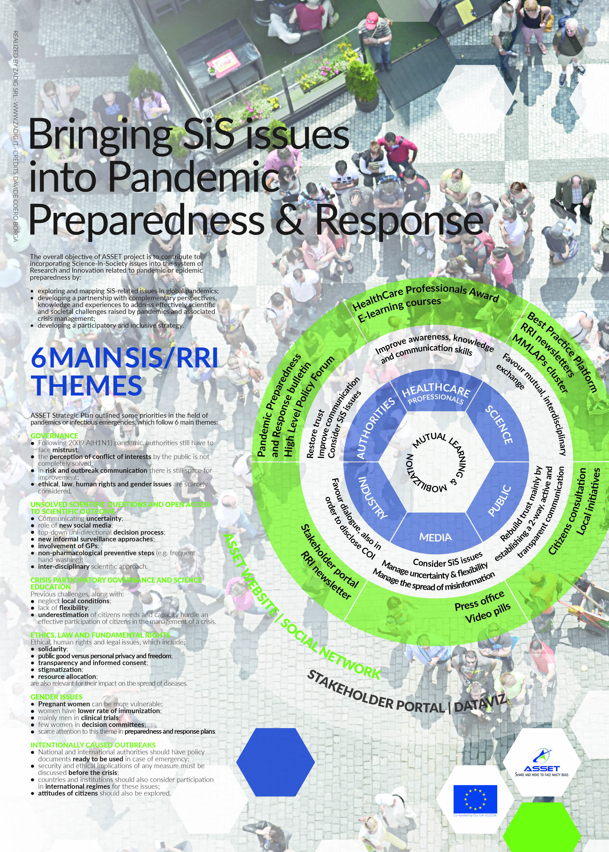
ASSET CORE: PLAN FOR ACTION
CITIZENS’ CONSULTATIONS in 8 EU Countries (Bulgaria, Denmark, France, Ireland, Italy, Norway, Romania, Switzerland) on September 24th, 2016
MML by Social Media Coverage, Best Practice Platform and Stakeholder Portal, Local Initiatives in 11 Cities (Rome, Milan, Paris, Lyon, Dublin, Athens, Brussels, Oslo, Sofia, Bucharest, Geneva, Haifa)
POLICY WATCH through a High Level Policy Forum and 7 thematic Pandemic Preparedness and Response Bulletins

Slide 18
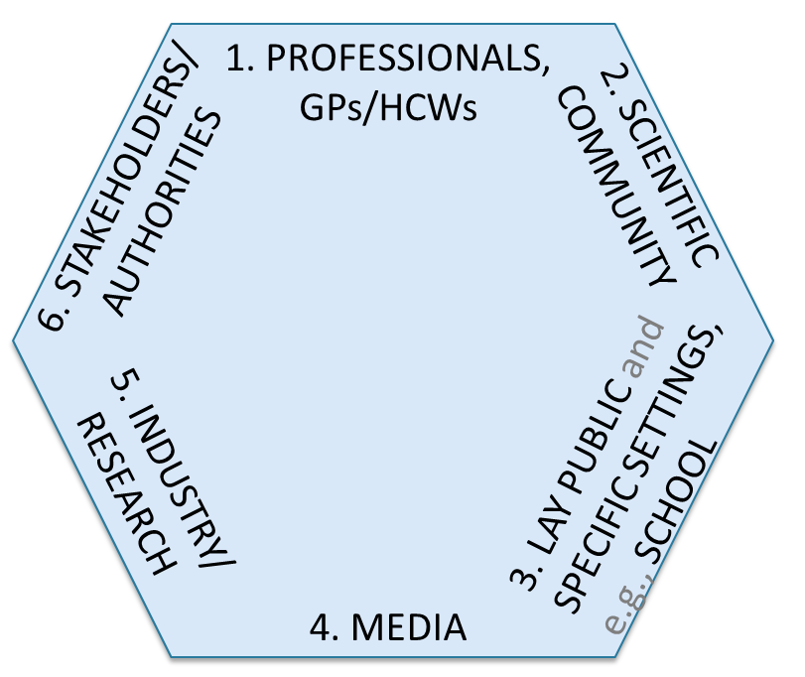
ASSET COMMUNICATION TARGETS
1. HEALTHCARE PROFESSIONALS
• Improve awareness, knowledge and communication skills
Best Practice Award (3); Summer School (3)
2. SCIENCE
• Favour mutual, interdisciplinary exchange
Paper Series (8)
3. PUBLIC
• Rebuild trust mainly by establishing a two-way, active and
transparent communication
Liaison with Erasmus Plus Program
4. MEDIA
• Consider SiS issues; • Manage uncertainty and flexibility;
• Manage the spread of misinformation;
Videopills, press-kits
5. INDUSTRY
• Favour dialogue, also in order to disclose Conflict of Interest
RRI Newsletter (6)
6. AUTHORITIES
• Restore trust; • Improve communication; • Consider SiS issues
Gender Platform

Slide 19
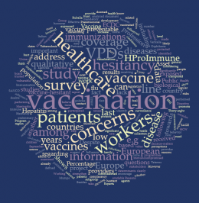
AN EXAMPLE TOPIC: VACCINATION
SCIENCE-IN-SOCIETY AND RESPONSIBLE RESEARCH AND INNOVATION RELATED ISSUES
ETHICS, GENDER, GOVERNANCE, LAW ENFORCEMENT
PEOPLE INCLUSION AND ENGAGEMENT
CURRENT CHALLENGE IN PUBLIC HEALTH
VACCINE HESITANCY, LOW COVERAGE, NO-VAX
Notes:
An example that fits for all the reasons presented so far

Slide 20
FUTURE PERSPECTIVES
Governance (within the frame of the EU Decision 1082/2013)
Open Access to Data and Information
Ethical Issues
Gender Pattern
Communication for Public Engagement
Science Education
Define chain of command; Set up a permanent ‘listening’ system to citizens’ voice; Plan and coordinate integrated health risk communication strategies; Deliver continuous professional training on health risks, Develop preparedness simulation exercises periodically
Circulate scientific/evidence-based information on regular basis; Address people hesitancy on prevention actions
Tackle stigma and frailty in groups at-risk during health emergencies; Outline rules and limits of potential conflicts between response measures in emergencies and people freedom and privacy; Address procedures on international health risks and migrants
Provide gender tailored responses; Prioritize the female resource potential on health management; Sensitize women both in abiding by non-pharmacological interventions and to vaccination compliance
Prepare integrated preparedness communication plans according a multistakeholder approach; Be constantly proactive on social media; Ensure rapid and appropriate response against misinformation; Monitor risk communication trends for evidence and practices
Include health preparedness and communication in the basic HCWs’ curricula and continuous education programs; Empower the pathway toward a responsible open science
Notes:
Conclusions and Future Perspectives
As the wide range of ASSET activities shows, to cope effectively with PHEIC not only medical or healthcare interventions are needed due to potential unwanted side effects on the population: an integrated participatory approach is crucial and should be embedded into the national preparedness plans. Countries are thus required to set out risk communication appropriately in their own response and preparedness strategies. Basing on ASSET outcomes, relevant key perspectives to be addressed in the future according to the recalled SiS-RRI [21,22] categories can be listed as follows:
1) Governance (within the law reference frame of the EU Decision 1082/2013) [Define chain of command, Set up a permanent ‘listening’ system to collect citizens voice, Plan and coordinate an integrated health risk communication strategy, Deliver a continuous professional training and update on health risks, Develop periodical preparedness simulation exercises];
2) Open Access to Data and Information [Provide regular information scientifically/evidence-based, Address people hesitancy on prevention actions, as vaccinations, prophylaxis, isolations/quarantine];
3) Ethical Issues [Tackle stigma and frailty groups at-risk in health emergencies, Outline rules and limits of potential conflicts between response measures in emergencies and people freedom and privacy, Address procedures on international health risks and migrants];
4) Gender Pattern [Provide gender tailored health emergencies responses, Prioritize the female resource potential on health management, Sensitize women both in abiding by non-pharmacological interventions and to vaccination compliance];
5) Communication for Public Engagement [Prepare integrated preparedness communication plans according a multistakeholders approach, Be constantly present and proactive on social media, Control and react to inappropriate information by delivering a rapid and appropriate response, Monitoring both evidence in literature and practices/experiences on risk communication];
6) Science Education [Devote part of the continuous education program for Health Care Workers to health preparedness and response, scientific evidence, health communication, Include health preparedness and communication into the basic HCW curricula, Offer upgrade training to media/communication operators on health preparedness, scientific evidence and health literacy, Empower the pathway toward a responsible open science].

Slide 21
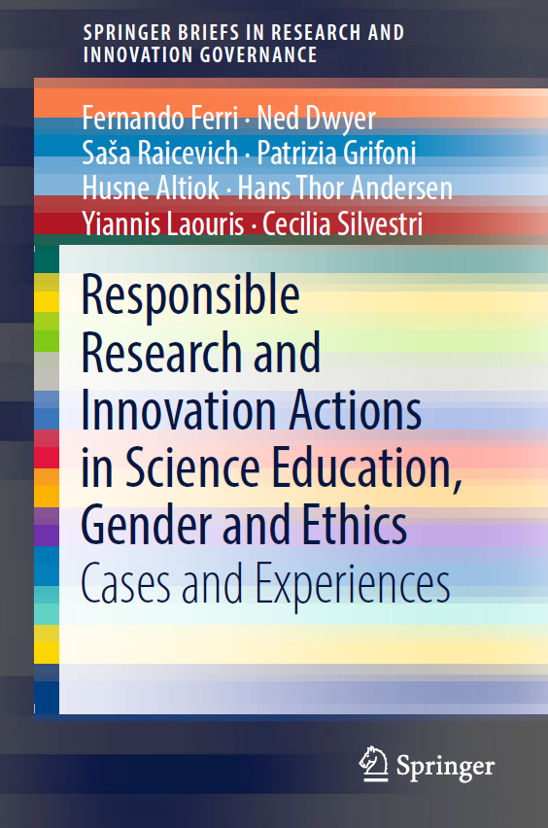
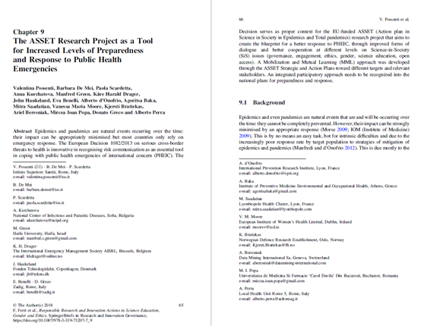
REFERENCES

Slide 22

“Improving healthcare means challenging the status quo.”
José Merino
BMJ 2018;361:k2277 doi: https://doi.org/10.1136/bmj.k2277
Published 24 May 2018
We hope ASSET at least offered a range of ways to try doing that.

